Slide 1



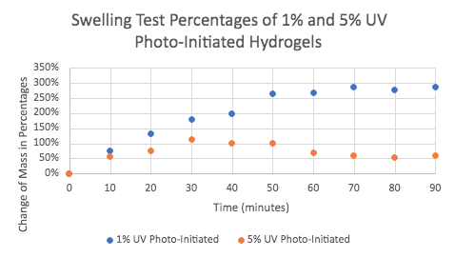
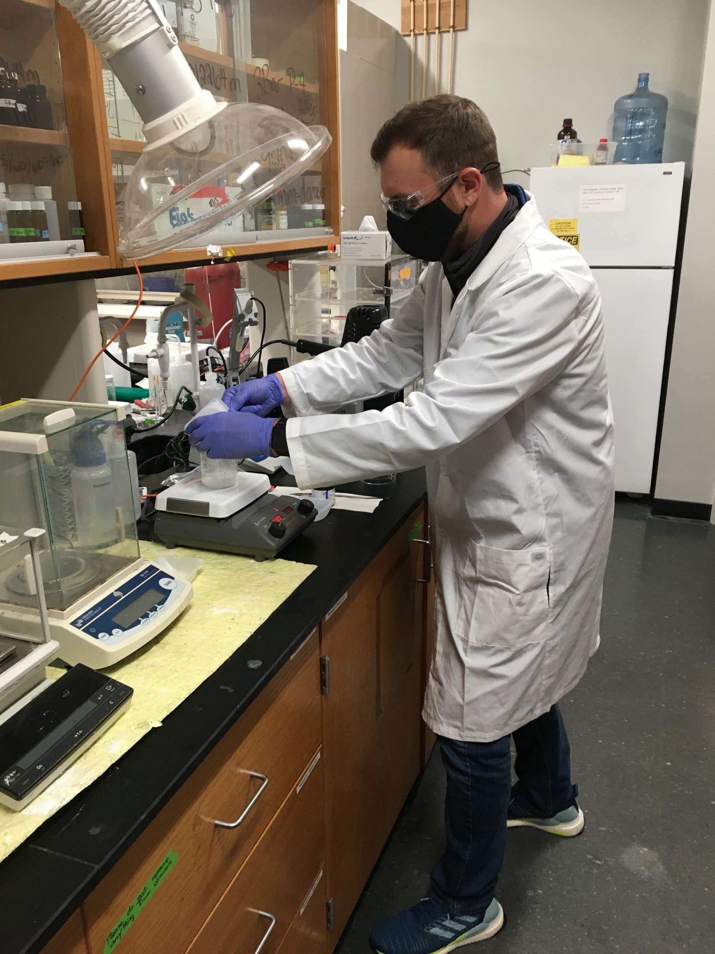
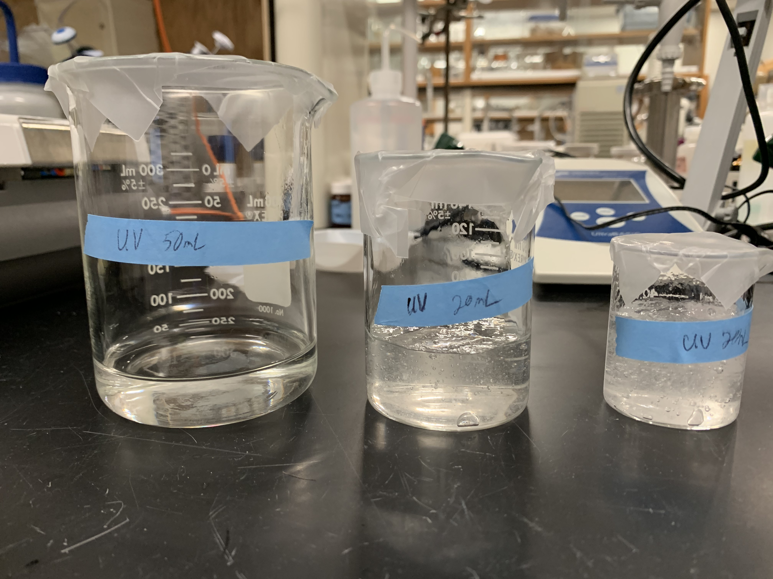
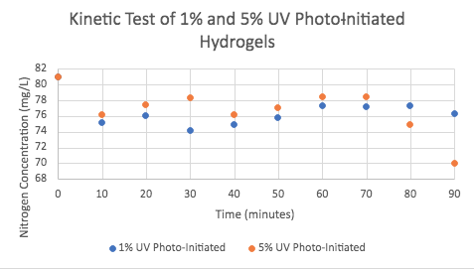
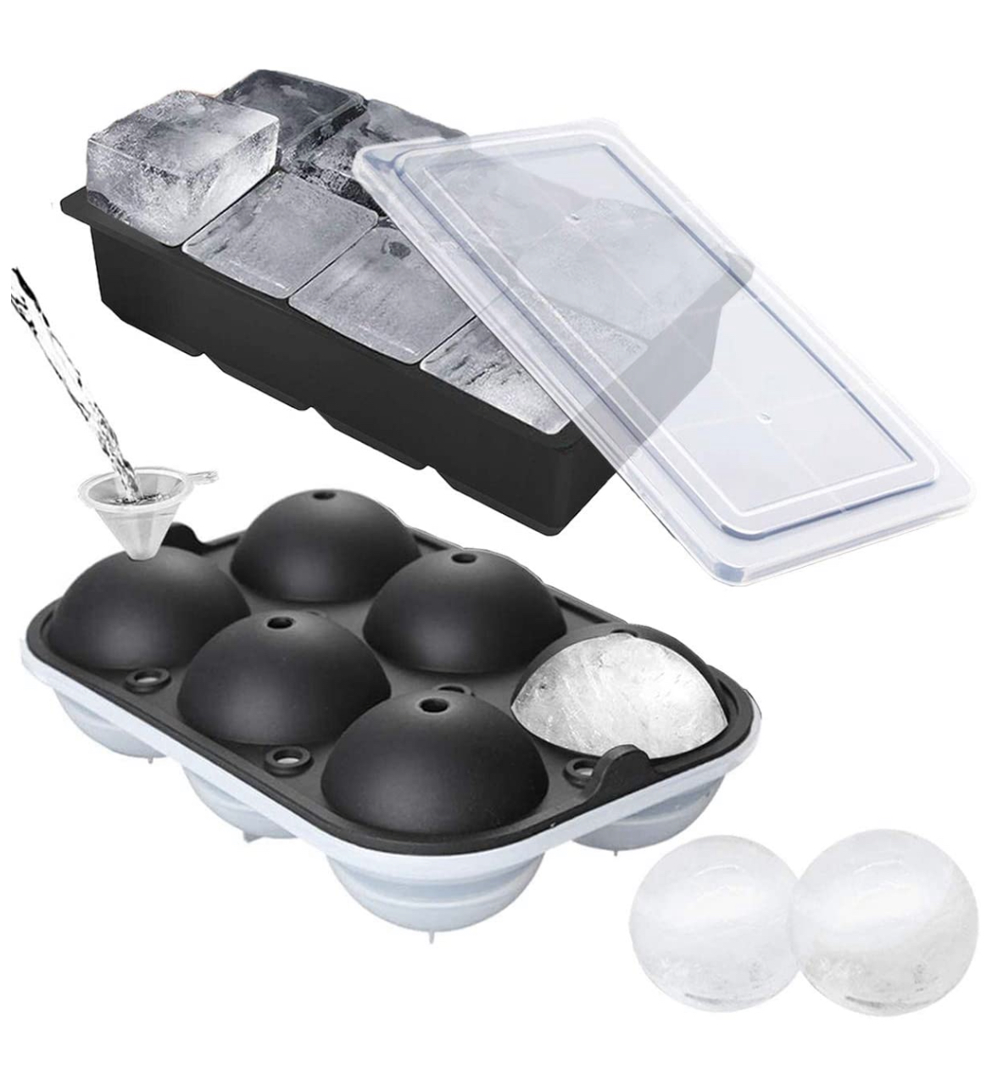
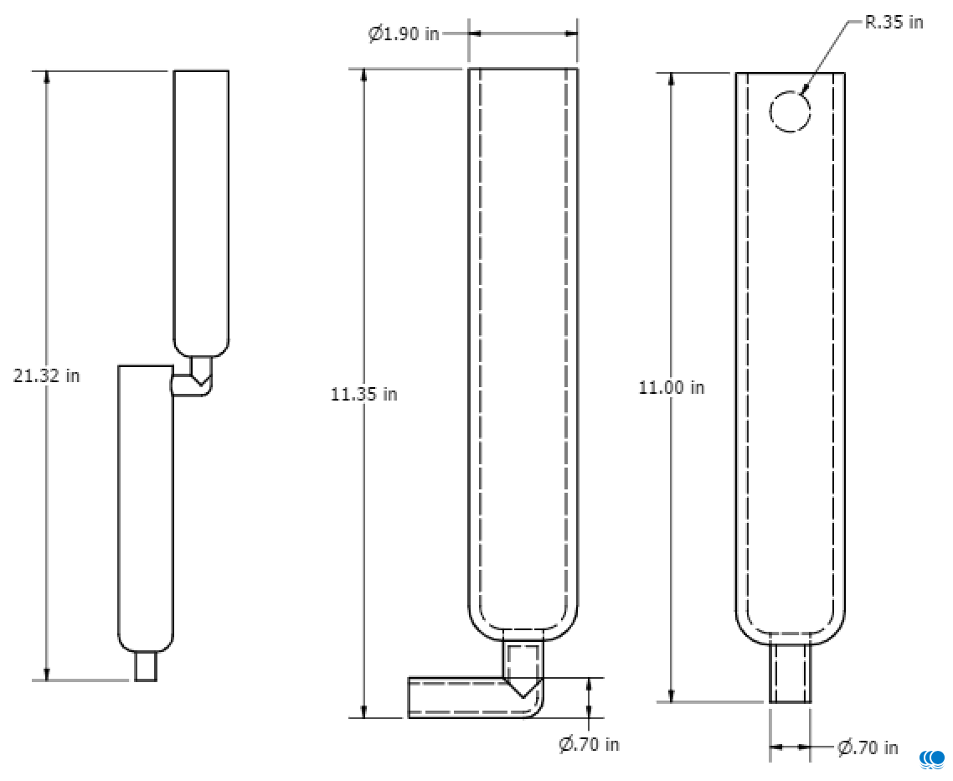
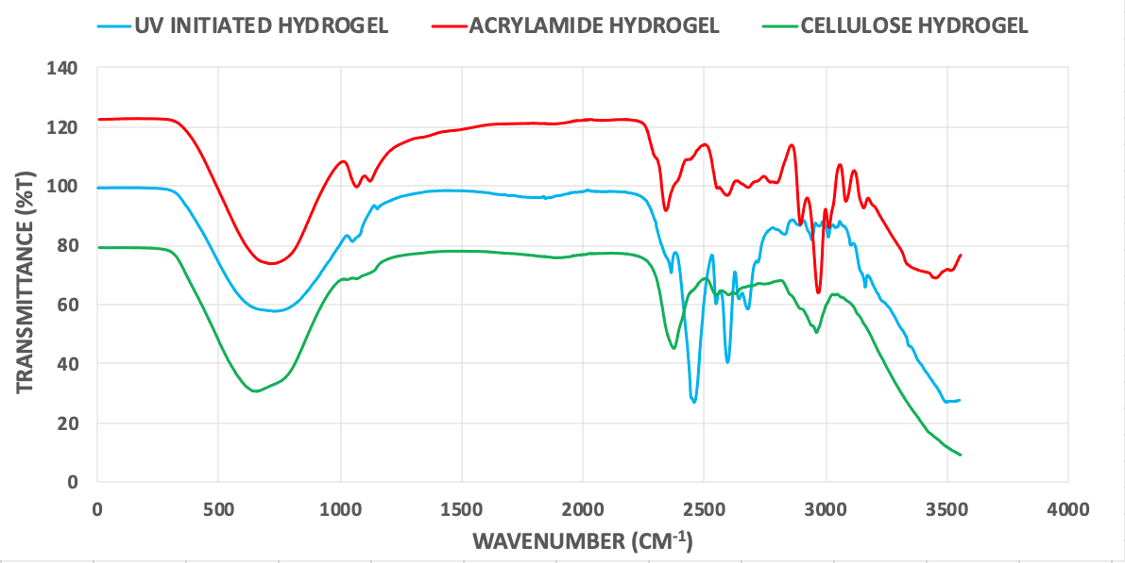
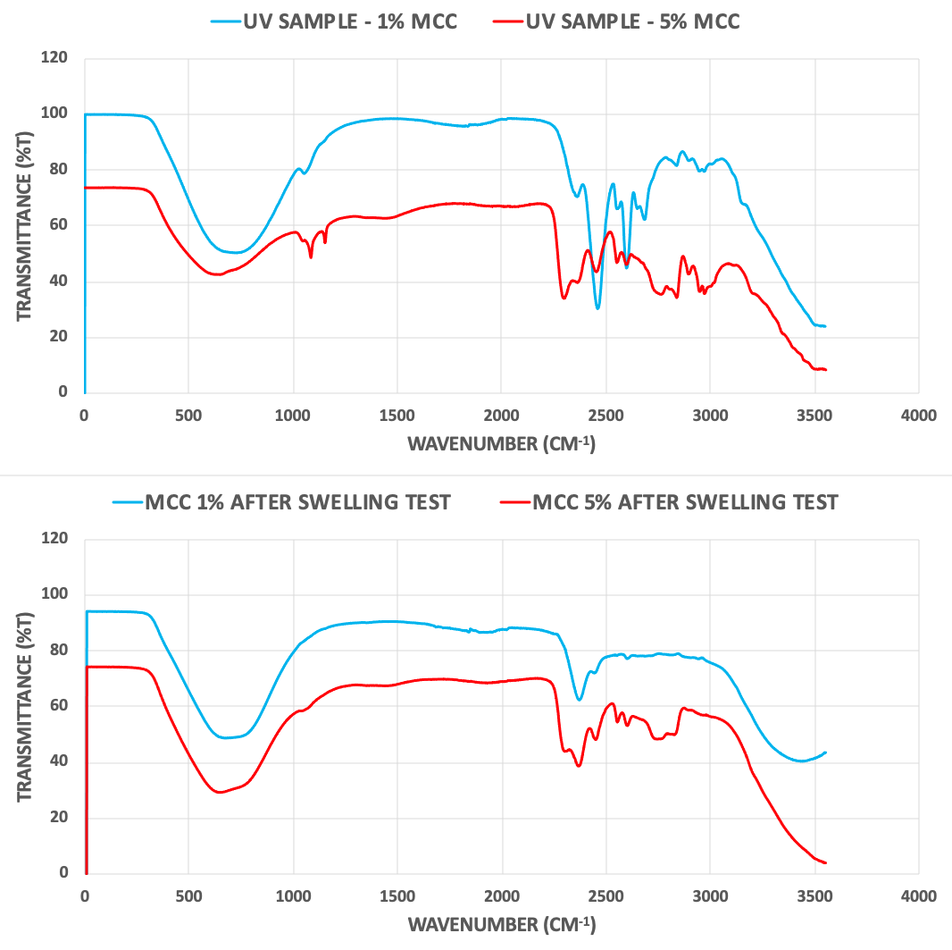
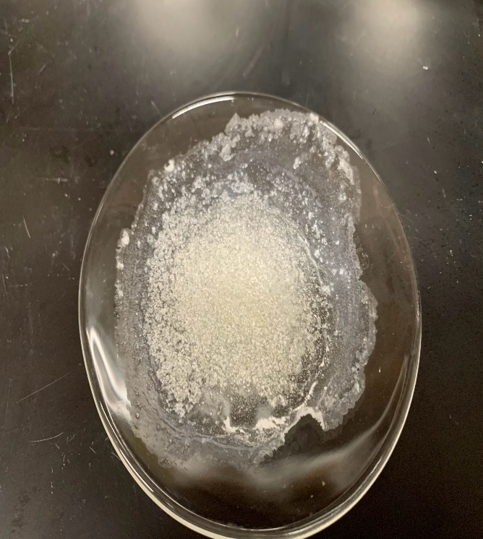
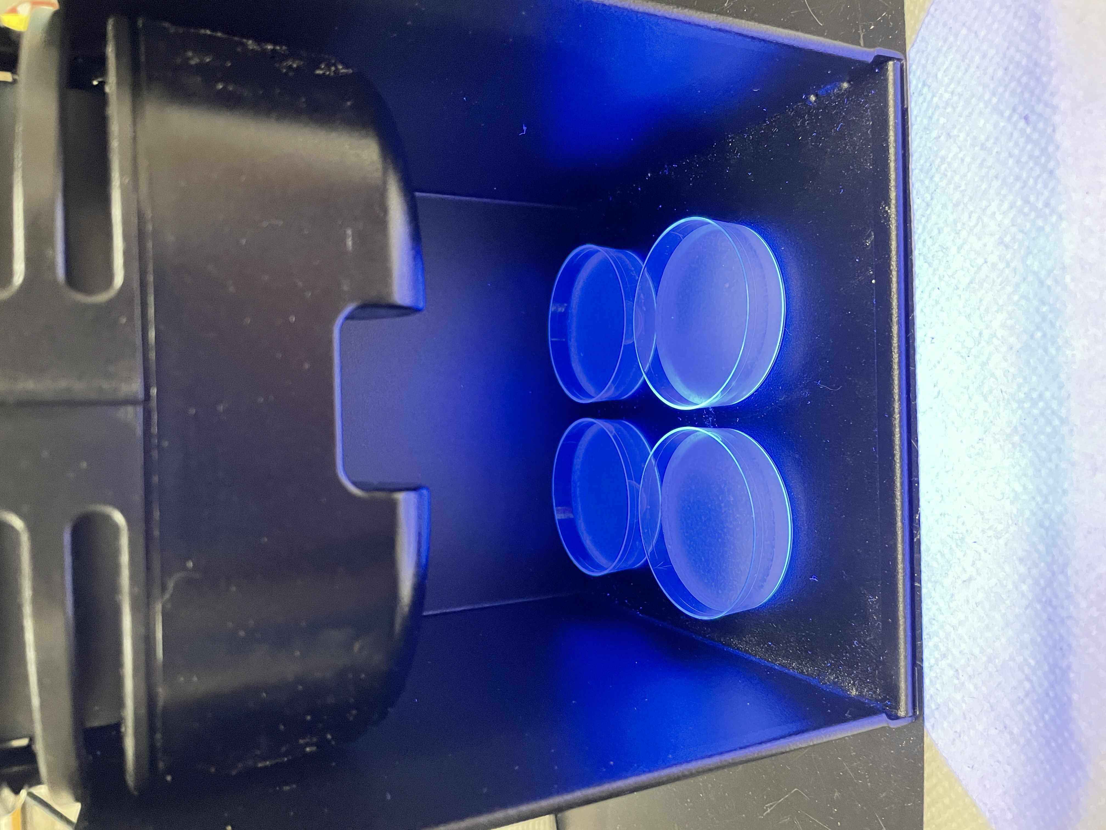
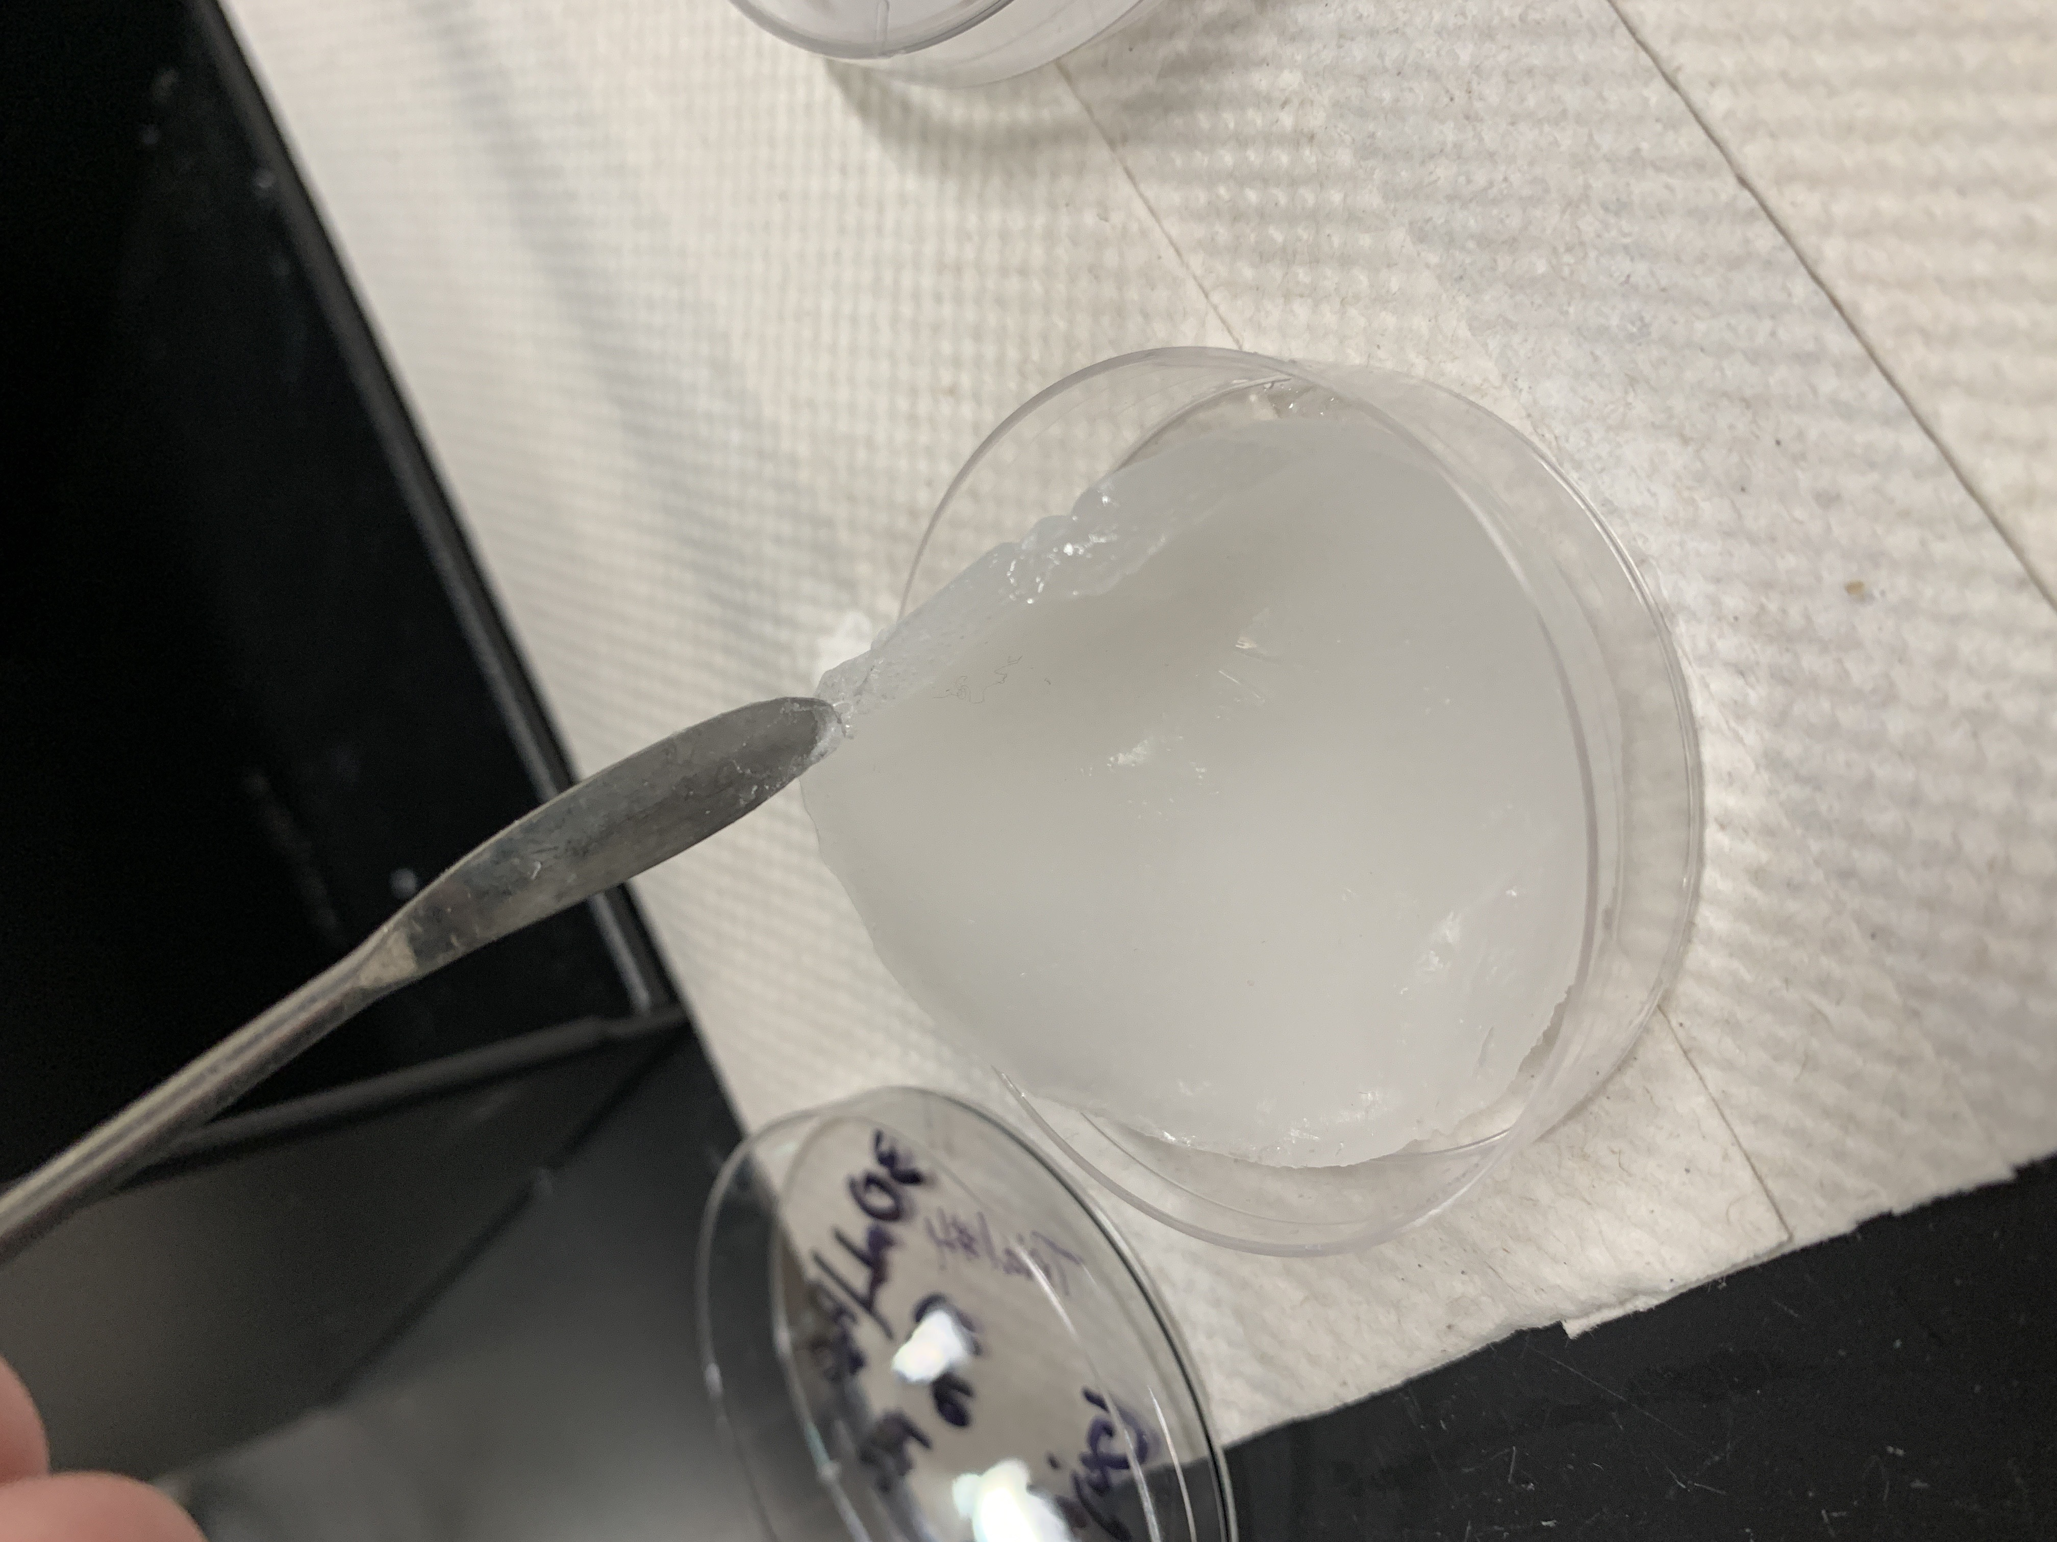
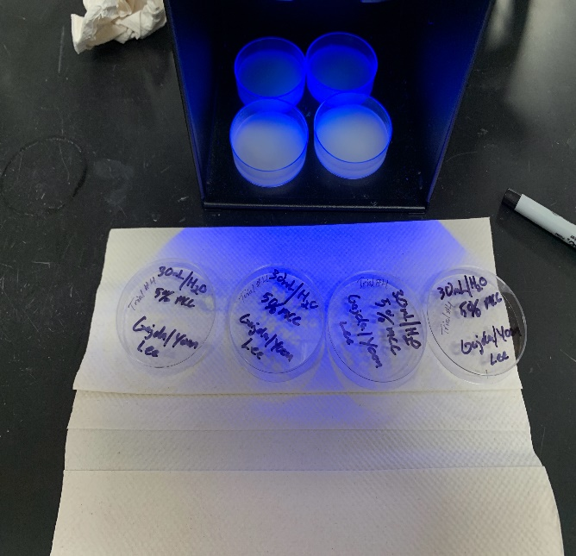
Nutrient Recycle Using Hydrogels Synthesized via UV Photo-initiation Jason Gajda, Kiana Treaster, William Yoon, Seungjin Lee
School of Science and Technology, Georgia Gwinnett College, Lawrenceville, GA
Abstract
Results
Future Application
Hydrogels can be designed to remove and recycle nutrients, such as nitrogen from urine by utilizing their absorption and desorption properties. Hydrogels can be synthesized using various methods such as refrigeration, sonication, and UV photo-initiation. Each method will yield a different hydrogel with different properties. To better understand these properties, synthesized hydrogels can be characterized using FT-IR spectroscopy, kinetic, isotherm, and swelling tests. Synthesis methods such as refrigeration when making cellulose hydrogels can take multiple days for polymerization to occur; however, these hydrogels can sometimes be structurally unstable. Concerted efforts have been employed to develop more time-efficient methods while producing a more robust hydrogel. Through preliminary studies, it is understood that polymerization through UV photo-initiation can be a much more efficient method. Along with aspects of optimization, the photoinitiated polymerization process presents comparable characteristics and performance results to polyacrylamide and microcrystalline cellulose based hydrogels, while the production process remains more functional and expedient. At this time, the micro-crystalline cellulose reinforced polyacrylic hydrogel samples synthesized using a photo initiator and a UV light source appear to be the most optimal synthesis process for the scope of this research. There will also be further investigation involving hydrogels produced using molds and sonification to achieve polymerization.
Refine Procedure
Produce a stable, functional, and easily reproducible UV photo-initiated procedure. Currently there appears to be structural limitations to MCC reinforced poly- acrylamide hydrogels.
New Testing Methods
Swelling and kinetic testing are both conducted to determine the performance levels of each type of hydrogel. However other methods may be necessary to determine the structural integrity of these hydrogel samples.
Figure 1. Swelling Test Percentages of both 1% and 5% UV Photo-Initiated MCC polyacrylamide hydrogels.
Step 2
3D Molds
Background & Significance
The use sphere and cube shaped molds with matrix mesh reinforcement structures will be explored in the future to improve the application capabilities of these samples.
Wastewater treatment has been a resource used to protect the health of humans and other biological species from various waterborne diseases. However, the removal of various contaminants and pollutants, such as nitrates and phosphates, using traditional wastewater treatment is ineffective. Hydrogels may be a useful resource for water treatment and the absorbance of toxic compounds and nutrients. Hydrogels are hydrophilic groups that have three-dimensional polymeric cross-linked structures capable of swelling in aqueous solutions. The performance of these hydrogels can be affected by changes in pH, temperature, and pressure, making them swell or shrink. The functionality of hydrogels can be measured by their swelling, adsorption, and desorption capabilities. This research project produced hydrogels using various polymers such as microcrystalline cellulose (MCC), polyacrylamide, acrylic acid, and a hybrid, which contains both cellulose and acrylamide. The primary focus of research is to synthesize a structurally stable hydrogel that is effective in adsorbing nitrogen from synthetic urea and effectively releases the nitrogen in the presence of water to be recycled and used again. If the research is successful, hydrogels may be an effective, inexpensive, and biodegradable solution for water treatment.
Develop Flow Column
Figure 2. Kinetic Test of both 1% and 5% UV Photo-Initiated MCC polyacrylamide hydrogels.
Future tests will include three dimensional shaped hydrogels to be used within a column. Parameters of testing will include temperature, flow rate, and bed depth.
Characterization – FT-IR Analysis
Conclusion
The short polymerization time and stable structure of the UV photo-Initiated hydrogel is the most efficient and functional method.
The swelling and kinetic test results of the UV photo-initiated hydrogel samples show higher levels of performance when up taking aqueous solutions and extracting nitrogen from synthetic urea.
in the presence of aqueous solution, the UV photo-initiated hydrogel did not maintain its structure, continued to swell, and eventually deteriorated completely.
Proposed solutions for structural issues include introducing sodium bicarbonate or other methods to create a more porous structure as well as the use of mesh and molds to reinforce the shape of the hydrogel.
UV Photo-Initiated Synthesis Method
Figure 3. Stacked IR spectra showing the structural variations between three different hydrogel samples.
UV Photo-Initiated Procedure
Introduction of H₂O to the Synthesis
Limitations to the Procedure
Samples with Varied MCC Percentages
Acknowledgement & Disclaimer
ACKNOWLEDGEMENT:
This Material Is Based upon Work Supported by the National Science Foundation: Grant No. 1826920.
PROJECT TITLE:
MRI: Acquisition of Total Organic Carbon/Total Nitrogen Analyzer for Interdisciplinary Research and Teaching at Georgia Gwinnett College.
DISCLAIMER:
ANY OPINIONS, FINDINGS, and CONCLUSIONS or RECOMMENDATIONS EXPRESSED in THIS MATERIAL ARE THOSE of the AUTHORS and DO NOT NECESSARILY REFLECT the VIEWS of the NATIONAL SCIENCE FOUNDATION.
Samples produced using the original UV photo-initiated MCC reinforced polyacrylamide hydrogel procedure were synthesized with no water. They were successful, however while mixing, the ingredients did not distribute properly because of the small volume of solution. Ultimately, producing samples which were not uniform.
Once water was introduced to the procedure the various elements of the procedure were able to mix properly and the samples became much more uniform and could be reproduced efficiently. Based on the results, this modification was a success and the samples produced were now more robust and functional.
After several swelling tests it was determined that the performance of the original procedure was phenomenal. However, for the scope of this research and for a more uniform and functional application, the swelling capacity was too great. To address this issue research was conducted and an appropriate solution was developed.
To reduce the swelling capacity to a more uniform and controlled level it was determined that if the percentage of MCC was increased the swelling capacity would become more manageable. This idea was proven to be a success and the capacity was now more predictable. Unfortunately, this would present other issues.
Works Cited
Ni, J.; Wen, Y.; Liu, H. Preparation of Micro-Crystalline Cellulose-Reinforced Polyacrylic Acid Hydrogel and Its Application in Paper/Polyacrylic Acid Composites. Bioresources 2015, 10 (3). https://doi.org/10.15376/biores.10.3.4843-4853.
Bahram, M.; Mohseni, N.; Moghtader, M. An Introduction to Hydrogels and Some Recent Applications. In Emerging Concepts in Analysis and Applications of Hydrogels; Majee, S. B., Ed.; InTech: London, England, 2016.
Figure 4. Stacked IR spectra showing the variation between UV photo-initiated hydrogel samples produced with two different microcrystalline percentages (above). The same samples are shown after a swelling test (below).

